Slide 1
Koshur: A Historical Outlook
Shelly Jain, 20171008

Slide 2
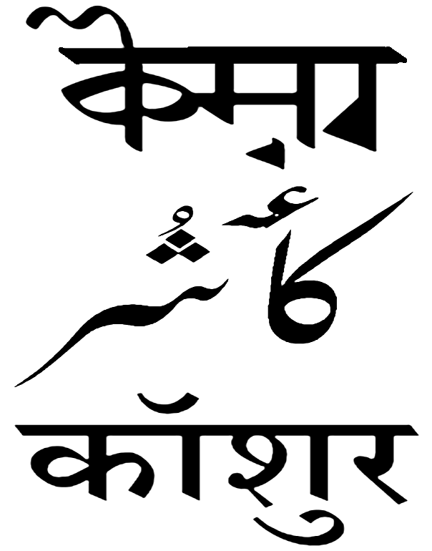
Overview
Pronunciation: [kəːʃur]
Native to: Jammu and Kashmir Region, Kashmir valley, Chenab valley
Ethnicity: Kashmiris
Native speakers: 5.6 million in India (2001 census)
Classification: Indo-European → Indo-Iranian → Modern Indo-Aryan → North-Western → Dardic → Kashmiri
Major dialects: Kishtawari, Poguli
Writing system: Perso-Arabic script (contemporary), Devanagari script (contemporary), Sharada script (ancient/liturgical)

Slide 3
Koshur today
Kashmiri, or Koshur (कॉशुर, کأشُر‬), is spoken primarily in the Kashmir Valley and Chenab Valley of Jammu and Kashmir. There are also around a hundred thousand Kashmiri speakers in Pakistan. The major spoken dialects are Kishtawari, Poguli, and Rambani. Most Kashmiri speakers use Urdu or English as a second language.
By origin it is Dardic, but it has gained a predominantly Indo-Aryan character. Reflecting the history, the vocabulary is mixed, having Dardic, Sanskrit, Punjabi, and Persian elements.
Religious differences are evident in vocabulary and choice of alphabet. Muslims use Persian and Arabic words; they also use the Persian form of the alphabet. Hindus favour words derived from Sanskrit and write Kashmiri in the Sarada alphabet, a script of Indian origin. In printed books, the Devanagari character is used. There is a small amount of Kashmiri literature.

Slide 4
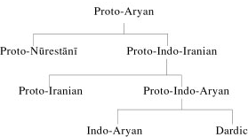
Classification

Slide 5
Origin
Koshur shows several influences. It is accepted that Kashmir was once inhabited by a tribe named Yakshas and Pisachas, who were overcome by the Aryan immigrants. Nilamat Purana, the special Purana of Kashmir, is clear evidence of this fact. It is impossible for the imported culture (Sanskrit) to not have interacted with the local vernacular; but the old speech of the original inhabitants (Pisachas), has remained firmly established in the non-literary people, who were in majority. Thus it can be said that the Kashmiri language has a Pisacha base. The Pisacha group of languages is now known as Darad group of languages.

Slide 6
As a Dardic language
The Darad languages possess many unique characteristics. In some respects these languages agree with Indo-Aryan languages and in other respects, with Iranian languages. It is assumed that Aryan is the parent stock from which the Indo-Aryan language branches at a very early date and passes to the Indo-Gangetic plain. Then before the other branch becomes Iranian, yet another branch shoots off, and settles in what we now call Dardistan and becomes Dardic.
The Dardic group comprises a number of speeches, which are current among very small mountain communities living on the frontier between Pakistan, Afghanistan and India (in Kashmir) as well as in North-eastern Afghanistan. They were originally referred to as ‘Kafir’ or ‘Pisacha’ dialects, before being given the linguistic name ‘Dardic’.

Slide 7
Unique characteristics
Kashmiri is closely related to Shina and some languages of the North-West frontier. It also shares some morphological features with Sindhi and Lahanda such as pronominal suffixes. It differs from all other Indo-Aryan languages in phonological, morphological and syntactic features.
Kashmiri has a set of central vowels, and dental affricates /ts/ and /tś/ which are not found in other Indo-Aryan languages. Also, the finite verb always occurs in the second position except in relative clause constructions - similar to German, Dutch, Icelandic and Yiddish, a distinct set known as Verb Second (V-2) languages. In V-2 languages, any constituent of a sentence can precede the verb. Kashmiri also shows several unique features which are different from other V-2 languages.

Slide 8
Script
There are three orthographical systems used to write the Kashmiri language: the Sharada script, the Devanagari script and the Perso-Arabic script. The Roman script is also sometimes informally used to write Kashmiri, especially online.
Kashmiri was written initially in Sharada, a script derived from Brahmi. After the propagation of Islam in the area, Muslims adopted the Urdu (Perso-Arabic) script to write the language. Hindus continued to use Sharada which later was replaced by Devanagari. Today, Sharada is used for ritual and religious purposes by some brahmans.
The Kashmiri version of the Perso-Arabic script follows the same conventions of the Urdu script, with vowels frequently indicated. There is some redundancy because several letters reflect the orthography of the numerous loanwords from Persian and Arabic.

Slide 9
Regional dialects
Kashmiri has several regional varieties spoken, which may or may not be mutually intelligible with each other and the standard.
Inside the Kashmir Valley
  Maraz (South, South-East)
  Kamraz (North, North-West)
  Srinagar and surrounding areas
Outside the Kashmir Valley
  Poguli
  Kishtawari

Slide 10
Regional dialects
Among the varieties spoken inside the Kashmir Valley, there are minor linguistic variations at phonological and lexical levels. They are mutually intelligible and quite homogeneous; the variations can be termed as different styles. Since the variety spoken in and around Srinagar has the prestige of being the standard variety, very frequent ‘style switching’ takes places from Marazi or Kamrazi styles. This is very common among the educated speakers. The Srinagar variety is used in mass media and literature.
Of the varieties spoken outside the Kashmir Valley, Poguli shares many linguistic features including 70% vocabulary with Kashmiri. Literate Poguli speakers of Pogul and Pakistan valleys speak standard Kashmiri as well. Kishtawari shares most of the linguistic features of standard Kashmiri, but retains some archaic features which have disappeared from the latter. It shares about 80% vocabulary with Kashmiri.

Slide 11
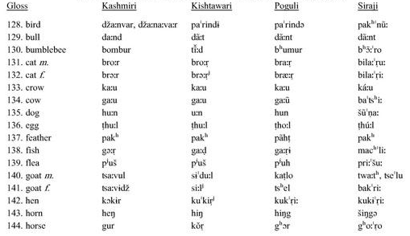
Regional dialects

Slide 12
Social dialects
There is some distinction between the speech varieties of Koshur spoken by the Hindu and Muslim communities, two major communities with native speakers. Kachru (1969) used the terms ‘Sanskritized’ and ‘Persianized’ Kashmiri to denote the differences on the grounds of variations in pronunciation, morphology and vocabulary common among Hindus and Muslims.
Most of the distinct Hindu vocabulary is derived from Sanskrit and the Muslim vocabulary from Person-Arabic sources. The dichotomy of these social dialects is not always clear-cut. There is style switching between the speakers of these two dialects, depending mainly on different situations and periods of contact between the participants of the two communities at various social, educational and professional levels.

Slide 13
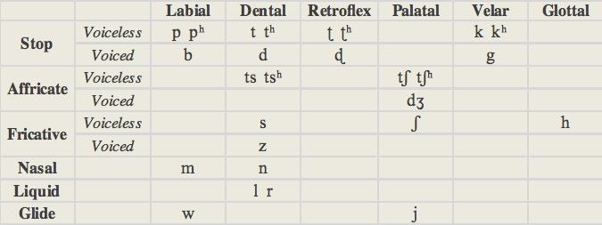

Phonology
In Kashmiri, tone and nasalisation are phonemic.

Slide 14
Phonology
Kashmiri, like the other Dardic languages, shows important divergences. One is the partial maintenance of the three sibilant consonants [s], [ṣ] and [ś] of the Old Indo-Aryan period. For another example, the prefixing form of the number 'two', which is found in Sanskrit as dvi-, has developed into ba-/bi- in most other Indo-Aryan languages, but du- in Kashmiri. ‘Seventy-two’ is dusatath in Kashmiri, bahattar in Hindi-Urdu and Punjabi, and dvisaptati in Sanskrit.
Certain features in Kashmiri even seem to originate from Indo-Aryan predating the Vedic period. For instance, there was an /s/ > /h/ consonant shift in some words that had already occurred with Vedic Sanskrit (this is observed even more frequently in Iranian languages), yet is lacking in Kashmiri equivalents. The words rahit and sahit in Vedic Sanskrit and modern Hindi-Urdu ('excluding' and ‘including’ respectively) correspond to rost and sost in Kashmiri.

Slide 15
Lexicon and semantics
Frequent borrowing - Kashmiri Language has thousands of loanwords from Persian and Arabic (due to the arrival of Islam) with a lesser amount from Sanskrit; it remains basically an Indo-Aryan language close to Rigvedic Sanskrit. There are minor differences between the Kashmiri spoken by Hindus and Muslims. For 'fire', a traditional Hindu will use the word agun while a Muslim more often will use the Arabic word nar.
Preservation of old Indo-Aryan vocabulary - Kashmiri retains several features of old Indo-Aryan that have been lost in other modern Indo-Aryan languages such as Hindi-Urdu, Punjabi and Sindhi. Some features date from the Vedic Sanskrit era and had been lost even in Classical Sanskrit. This includes the word-form yodvai (‘if’), which is mainly found in Vedic Sanskrit texts; Classical Sanskrit and modern Indo-Aryan use instead the word yadi.

Slide 16
Lexicon and semantics
First person pronoun - Both the Indo-Aryan and Iranian languages tend to eliminate the distinctive first person pronoun (‘I’) in the nominative case. The Indo-European root for this is reconstructed as *eǵHom, which is preserved in Sanskrit as aham and in Avestan Persian as azam.
This contrasts with the m- form (‘me’, ‘my’) used for the accusative, genitive, dative and ablative cases. Sanskrit and Avestan both used forms such as ma(-m). However, in Modern Persian, Baluchi, Hindi and Punjabi, the distinct nominative form has been entirely lost and replaced with m- in words such as ma-n and mai.

Slide 17
Lexicon and semantics
Kashmiri belongs to a relatively small set that preserves the distinction. 'I' is ba/bi/bo in various Kashmiri dialects, distinct from the other me terms. 'Mine' is myoon in Kashmiri. Other Indo-Aryan languages that preserve this feature include Dogri (aun vs me-), Gujarati (hu-n vs ma-ri), Konkani (hā̃v vs mhazo), and Braj (hau-M vs mai-M). The Iranian Pashto preserves it too (za vs. maa).

Slide 18
Morphology and syntax
Kashmiri, like German and Old English but unlike other Indo-Aryan languages, has V-2 word order. Like other Indo-Aryan languages, the verbal system relies on compound tenses, however the tense-mood auxiliary is before the main verb. Apart from verb position, word order is quite flexible. It is does not distinguish habitual/continuous tenses, or definite/contingent future.
There are two genders: masculine and feminine. Nouns are inflected for gender, number and case. Adjectives precede, and agree with, their nouns. Syntactic functions are marked mainly by postpositions in conjunction with cases.
Kashmiri has nominative, genitive, ergative and dative case. It is split ergative (restricted to past tense). Transitive verbs agree with object in gender and number while subject adopts ergative case. Intransitive verbs agree with subject which is marked in nominative case.

Slide 19
Language contact
There is great influence of contact languages on the varieties Kashmiri prevalent today. Some of the languages with the most influence are Persian and Arabic (in the Muslim community), Sanskrit (in the Hindu community) and English (among the educated youth).
Further influence comes from the regional languages (Dogri, Gojri, Ladakhi, Pahari and Balti), and other languages such as Tibetan. There is limited impact from Hindi and Urdu, and only minimal impact from the indigenous speech varieties of the residents.

Slide 20
Persian loanwords in Kashmiri
Phonology
Morphology
  Prefixation - Persian morphemes prefixed to Kashmiri stems or Kashmiri morphemes prefixed to Persian morphemes
  Suffixation - Persian stem attached to Kashmiri suffix or Kashmiri stem attached to Persian suffix
  Compounding - Persian as the second element or Persian as the first element
Lexical transfer - Semantic change or registers of religion, law and business
Literary styles

Slide 21
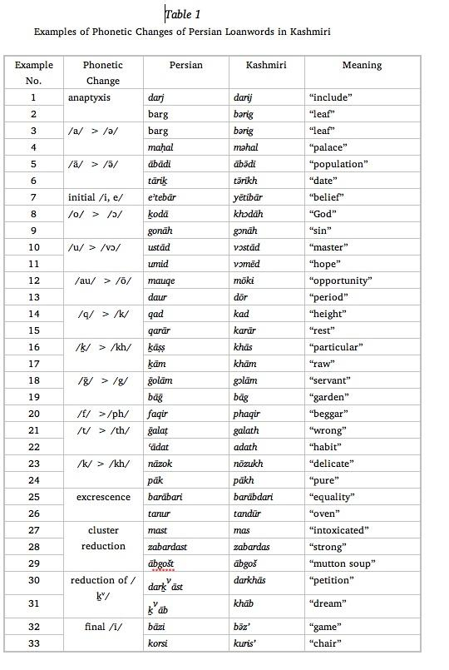
Persian loanwords in Kashmiri

Slide 22
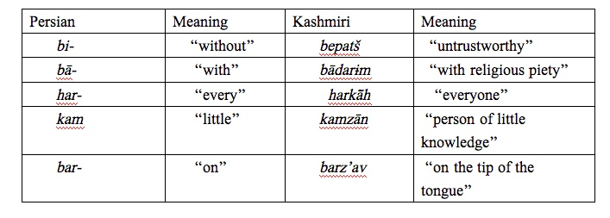

Persian loanwords in Kashmiri

Slide 23
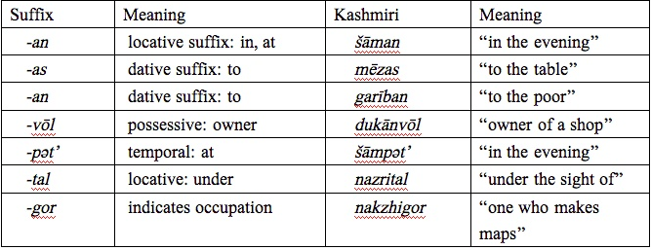
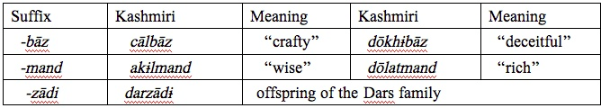
Persian loanwords in Kashmiri

Slide 24
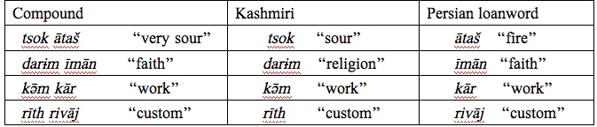
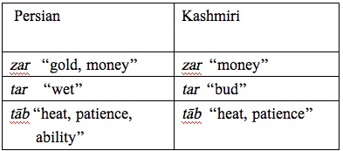
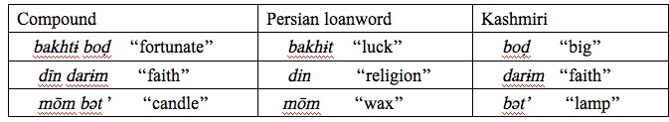
Persian loanwords in Kashmiri

Slide 25
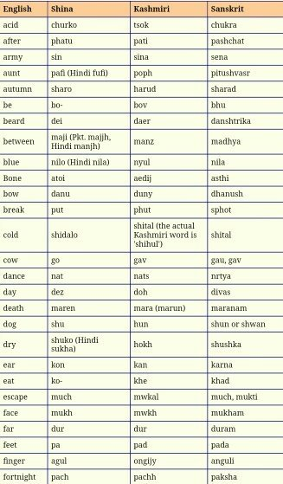
Sanskrit loanwords in Kashmiri

Slide 26
Thank
You

